Slide 1
Poetry Presentation
By Michelle Workman

Slide 2
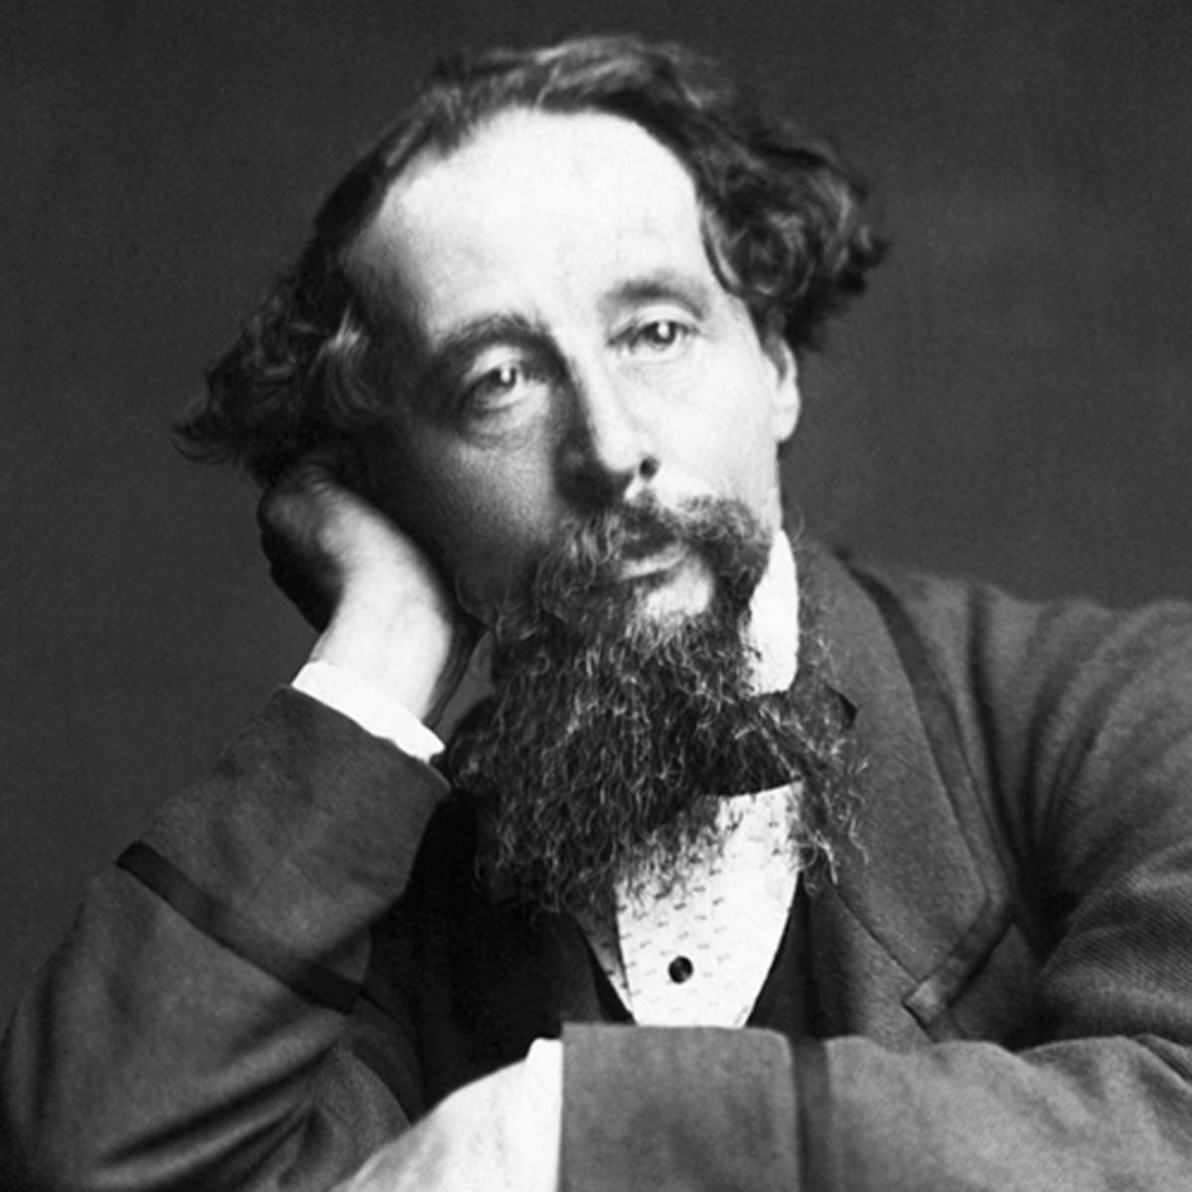
Interesting Facts About Charles Dickens
Most celebrated books: Oliver Twist, A Christmas Carol, A Tale of Two Cities
Was part of the Ghost Club, a society that was obsessed with the paranormal and tried to understand life after death
Was one of the few survivors, along with his mistress, of a massive train accident in June 1865

Slide 3
Excerpt from A Tale of Two Cities
“It was the best of times, it was the worst of times, it was the age of wisdom, it was the age of foolishness, it was the epoch of belief, it was the epoch of incredulity, it was the season of Light, it was the season of Darkness, it was the spring of hope, it was the winter of despair, we had everything before us, we had nothing before us, we were all going direct to Heaven, we were all going direct the other way,—in short, the period was so far like the present period, that some of its noisiest authorities insisted on its being received, for good or for evil, in the superlative degree of comparison only.”

Slide 4
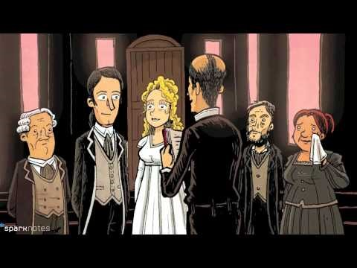

Slide 5
SIFT Literary Analysis
Show off your examples of SIFT – this might take more than one slide

Slide 6
Why I Chose This Poem
Overall message of poem
Why you chose this poem

Slide 7
Thank you for watching my presentation.

