Slide 1
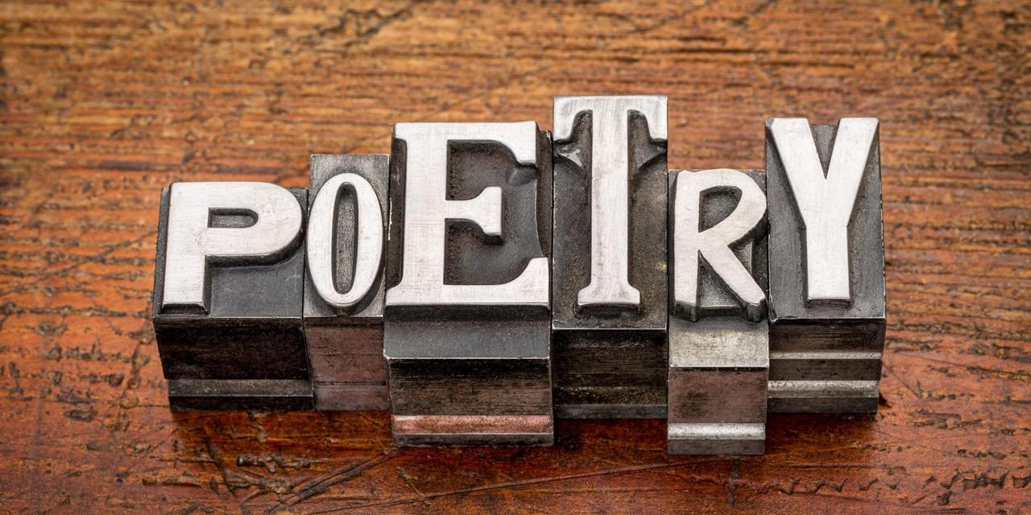

Slide 2
ACROSTIC
Poetry in which the first letter of each line, when read vertically, spell out a word. The word is usually the subject of the poem.
Vanilla
As I eat it on my brownie
Not doubting it’s sweet
Ice cream is a tasty treat
Lots of lingering taste
Lasting to the end
Always my favourite!

Slide 3
HAIKU
An ancient Japanese form with no rhyme. Haiku often deal with nature and has a fixed form
Line 1: five syllables
Line 2: seven syllables
Line 3: five syllables
The dying plant bends
And drips its dew to the ground
It falls like a tear

Slide 4
DIAMANTE
Diamond shaped poems of seven lines that are written using parts of speech.
Line 1: noun (subject)
Line 2: two adjectives
Line 3: three "ing" words
Line 4: four words about the subject
Line 5: three "ing" words
Line 6: two adjectives
Line 7: Synonym for the subject
Home
Safe, caring
Loving, sharing, talking
Friendship, food, car, travels
Living, loving, enjoying
Joyous, adventurous
Family

Slide 5
CONCRETE (SHAPE)
Poem that forms a picture. The shape of the poem reflects the subject.
Trees blossoming in the spring
Clouds above give rain
Fruit will come soon
Nature at its work
While
Trees
Stand
Still

Slide 6
More Examples of Concrete Poetry

Slide 7
COUPLETS
Two line poems with a fun and simple rhyming pattern. Each line has the same meter and their endings rhyme with one another. Couplets are often humorous.
My English teachers wants me to use imagination
So I go to math class and let my mind go on vacation!

Slide 8
QUATRAINS
Rhyming groups of four lines
Use letters to represent the rhyme pattern or scheme
There are four types of quatrain rhyme scheme: AABB (rhyming couplets), ABAB, ABBA, or ABCB
Picnic planning in July
Traveling up the mountains so high!
What an adventure for me
Because I prefer mountains to sea!

Slide 9
LIMERICKS
Whimsical poems with five lines
Lines 1, 2, and 5 rhyme
Lines 3 & 4 rhyme
Rhyme scheme of AABBAA
A flea and a fly in a flue
Were caught, so what could they do?
Said the fly, "Let us flee."
"Let us fly," said the flea,
So they flew through a flaw in the flue.

Slide 10
FREE VERSE
Poetry without rules of form, rhyme, rhythm, or meter
What do the oceans do at night?
Do they tease and tickle the bottom of boats?
Do they ripple away in fright?
Or are the beaches like coats
That keep them still and quiet
And once the day breaks and it's breakfast time
Do the oceans wish for some other diet than fish?

Slide 11
SONNET
Poems of 14 lines that begin with three quatrains and end with a couplet
Each line has ten syllables
The couplet usually contains a surprise ending or "turn".
William Shakespeare is one of the most famous sonnet writers in history.

Slide 13
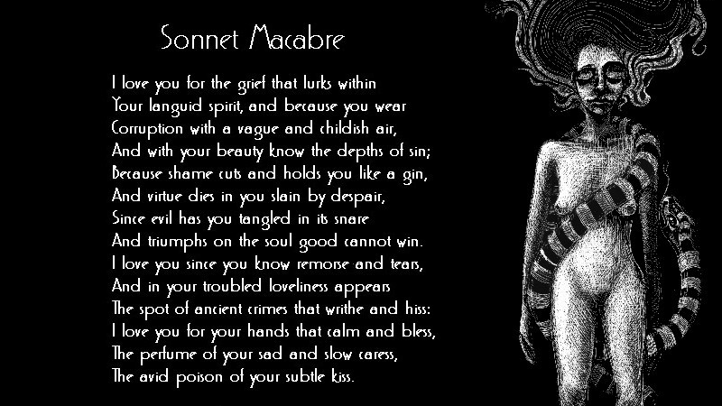

Slide 14
NARRATIVE
Poems that tell stories
An EPIC poem deals with a subject that is usually on a majestic scale and is usually fairly long
A BALLAD is a song like poem

Slide 15
